Slide 1
ATAC-seq and its data analysis
Haibo Liu
Department of Animal Science
Iowa State University

Slide 2
Outline
Introduction to the ATAC-seq technology
Preprocessing of ATAC-seq data
ATACseqQC workflow
Peak calling, filtering, and annotation
ATAC-seq data integration with other data
Best practices in ATAC-seq assays and ATAC-seq data analyses

Slide 3
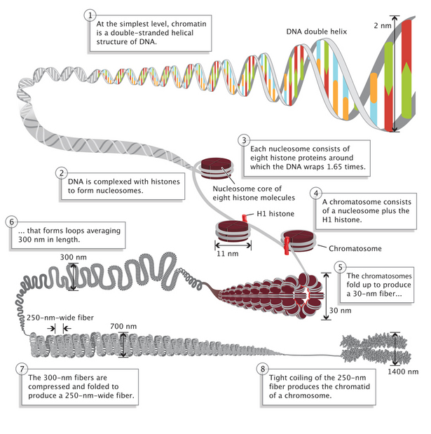
DNA packaging in Eukaryotic cells
Nature Education 1(1):26 (https://www.nature.com/scitable/topicpage/dna-packaging-nucleosomes-and-chromatin-310)

Slide 4
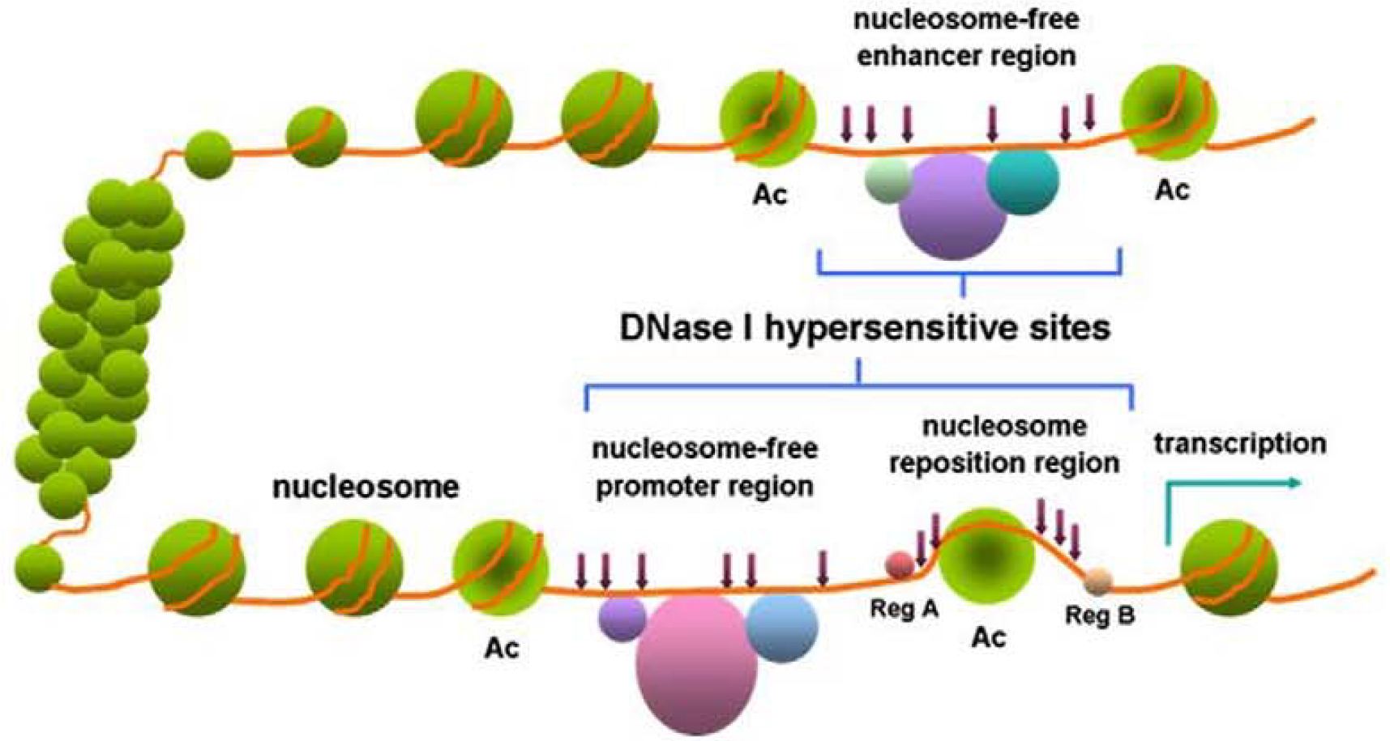
Open and closed chromatin
(Wang et al. 2012)

Slide 5
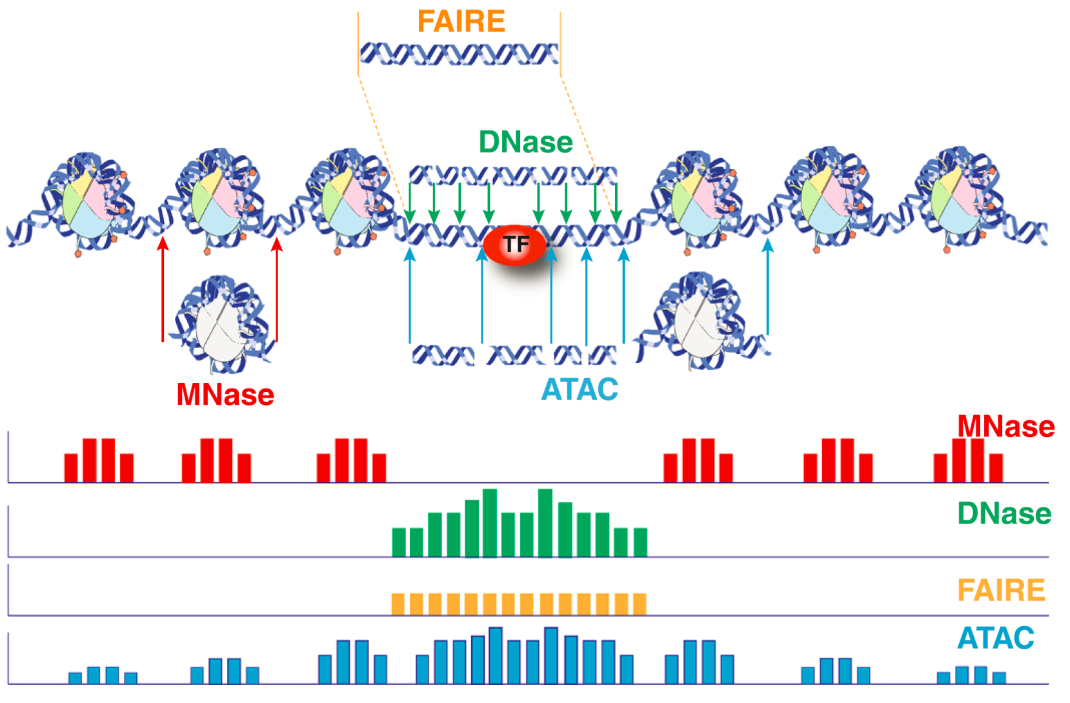
Methods for profiling chromatin accessibility
(Tsompana and Buck. 2014)

Slide 6
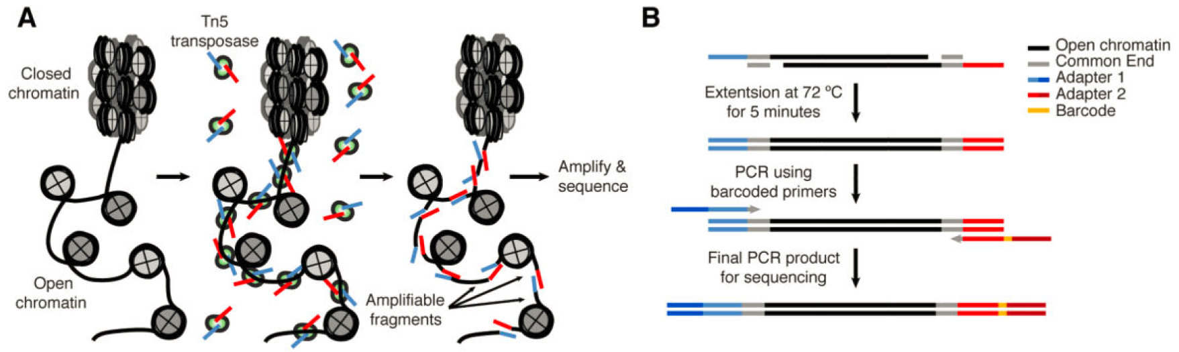
Workflow of ATAC-seq assays
(Buenrostro et al. 2013)

Slide 7
Applications of ATAC-seq
Infer nucleosome positioning
Profile open chromatin regions
Identify transcription factor (TF) footprints
Infer gene transcriptional regulation
Determine cell state/identity in combination with single cell technologies (scATAC-seq)

Slide 8
Experimental design
Replicates: ≥ 2 replicates per condition
Optional controls: similar to ChIP-seq input
Randomization + blocking: if comparing chromatin accessibility status between conditions is your interest

Slide 9
Experimental design: Other considerations
PCR amplification cycles: as few as possible to reduce PCR duplicates and PCR bias
Sequencing depth: depends on the size of the reference genome and the degree of open chromatin expected. More than 25 M uniquely mapped, non-dulicated fragments to the nuclear genome
Sequencing mode: 2X 50bp, paired-end sequencing
Better mapping rate
Accurate duplicate removal
Easy QC (library insert size distribution)
Accurate Tn5 insert sites, better chromatin accessibility estimate
For current ENCODE standards, see https://www.encodeproject.org/atac-seq/

Slide 10
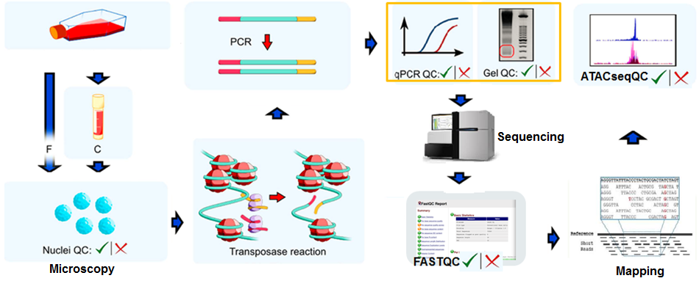
Important QC steps in ATAC-seq
Peak QC
Optimize Tn5 reaction
Fresh
Cryopreserve
(Modified from Milani et al. 2016)

Slide 11
Three stages of ATAC-seq data QC
Pre-alignment QC:
Total reads, Read/base quality, Duplication rate, GC bias, Adapter content.
Post-alignment QC:
Mapping summary, Duplication rate, Read distribution over chromosome, chrM contamination, Insertion length distribution, Library complexity, TSS enrichment.
Post-peak-calling QC:
Peak length distribution, Fraction of reads in peaks (FRiP), Background, Saturation analysis, Biological functions of peak assoicated genes.

Slide 12
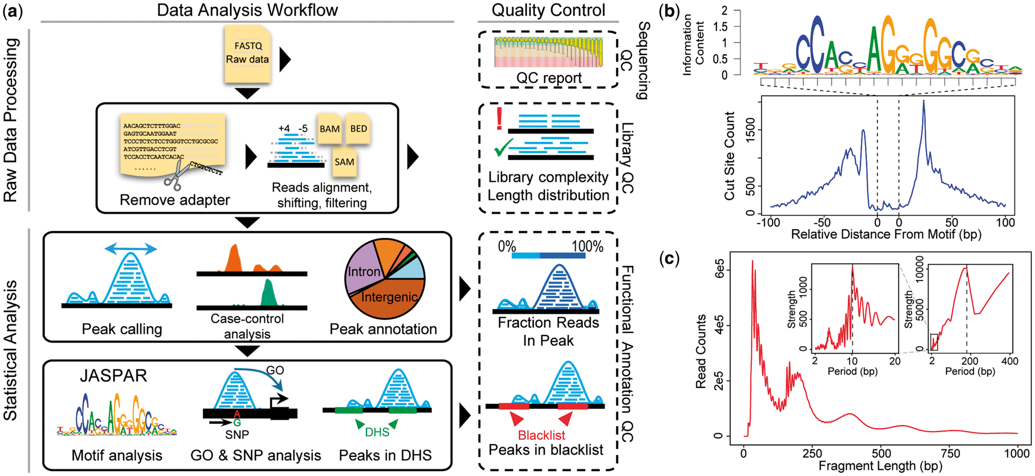

esATAC pipeline for ATAC-seq data analysis
Notes:
Fig. 1. (a) esATAC workflow. esATAC pipeline is mainly divided into two parts, raw data processing and statistical analysis. QC functions at multiple levels are provided, including sequencing QC, library QC and functional annotation QC. (b) and (c) Examples of analyzing ATAC-seq data (GEO accession number GSE47753, see Supplementary Material). (b) CTCF footprinting. (c) Fragment length distribution. Periodicity of approximately 200 base pairs (bp) for nucleosome protection and 10.4 bp for the pitch of the DNA helix is shown by fast Fourier transformation in the upper right corner
Unless provided in the caption above, the following copyright applies to the content of this slide: © The Author(s) 2018. Published by Oxford University Press.This is an Open Access article distributed under the terms of the Creative Commons Attribution Non-Commercial License (http://creativecommons.org/licenses/by-nc/4.0/), which permits non-commercial re-use, distribution, and reproduction in any medium, provided the original work is properly cited. For commercial re-use, please contact journals.permissions@oup.com

Slide 13
Outline
Introduction to the ATAC-seq technology
Preprocessing of ATAC-seq data
ATACseqQC workflow
Peak calling, filtering, and annotation
ATAC-seq data integration with other data
Best practices of ATAC-seq assays and ATAC-seq data analyses

Slide 14
Preprocessing of ATAC-seq data
Check quality of raw reads using (FASTQC).
Generate an interactive summary report (MultiQC)
Optionally, trim sequencing adapters and low quality bases using (Trimmomatic or Trim Galore!)
Map the reads to the reference genome of choice (Bowtie/Bowtie2 or BWA-mem)
Convert and sort alignment files (SAMtools, sambamba, Picard tools)
Filter aligned reads
Remove reads derived from organelles using SAMtools
Mark/remove duplicates (Picard tools)
Remove multi-mapping, and non-mapping reads
Remove mapping artifacts (insert size < 38 bp or insert size > 2 kb, reads with un-coordinated mapping) (custom scripts or deeptools alignmentSieve [https://deeptools.readthedocs.io/en/develop/content/tools/alignmentSieve.html])

Slide 15
Outline
Introduction to the ATAC-seq technology
Preprocessing of ATAC-seq data
ATACseqQC workflow
Peak calling, filtering, and annotation
ATAC-seq data integration with other data
Best practices in ATAC-seq assays and ATAC-seq data analyses

Slide 16
(1) Assessing mapping status of reads from ATAC-seq
BAM QC: bamQC()
mapping status, such as mapping rate, duplicate rate, genome-wide distribution, mapping quality, and contamination.
requires sorted BAM files with duplicate reads marked as input.

Slide 17
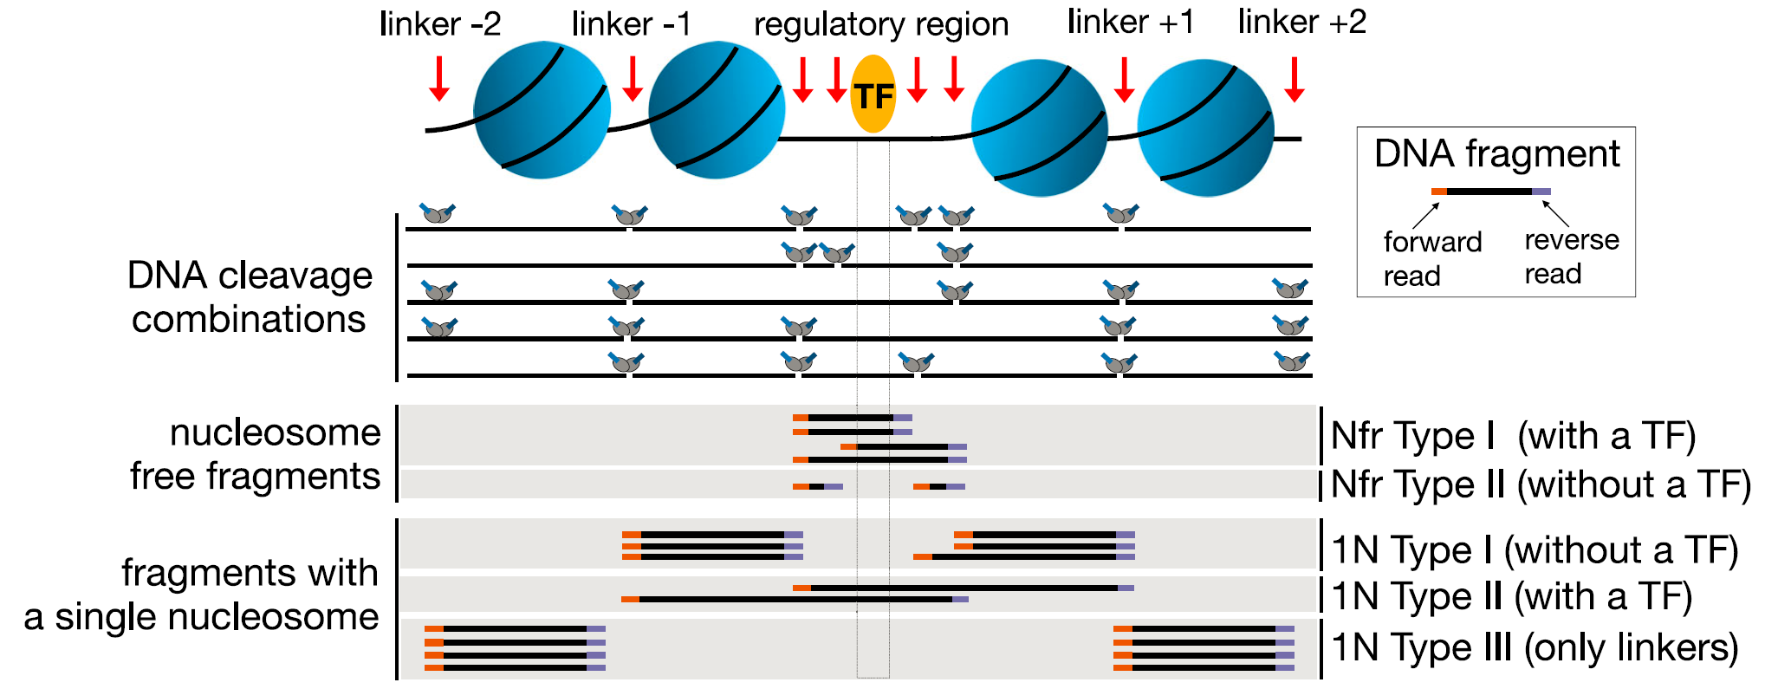
Characteristic DNA fragments generated in ATAC-seq assays
(Li et al. 2019)

Slide 18
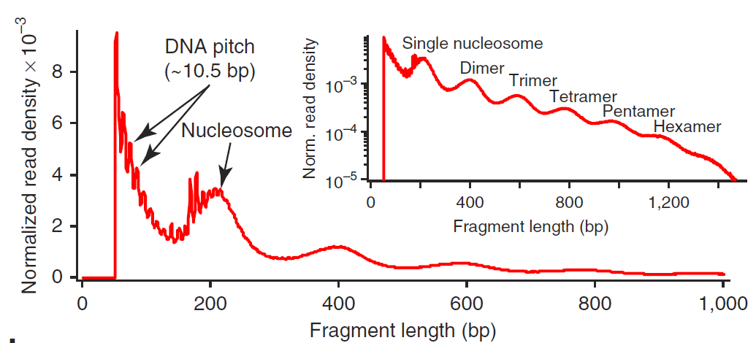
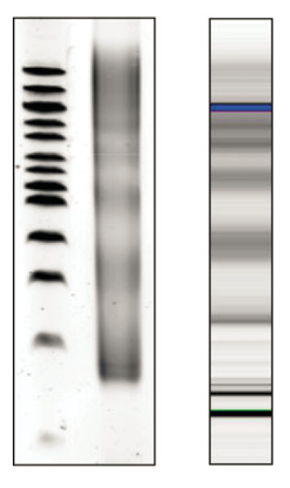
Typical size distribution of ATAC-seq library fragments/inserts
Library fragment size
Library insert size
Agarose Gel
Bioanalyzer
bp
400
200
fragSizeDist(bamfile, bamfile.labels)
(Buenrostro et al. 2013 and 2015)

Slide 19


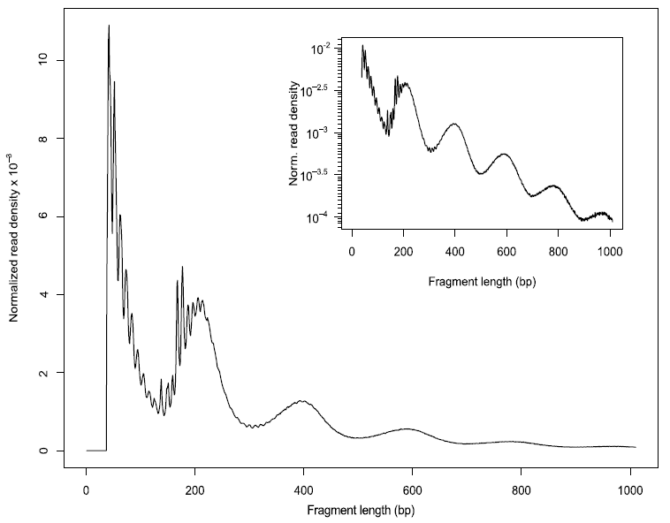
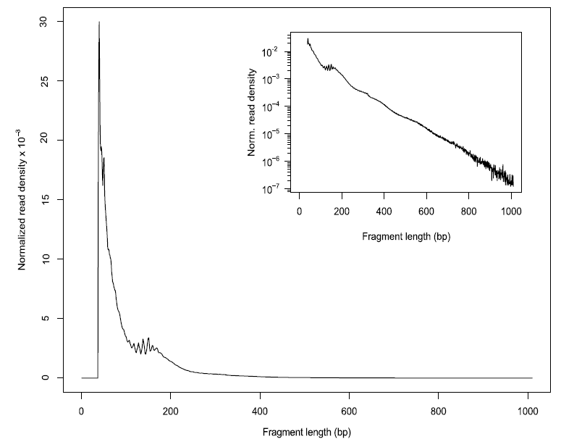
(2) Assessing insert size distribution
A (High quality)
B (Poor quality)
(Ou et al. 2018)

Slide 20
Minimal criteria for insert size distribution
NFR
You must see in the distribution of insert size:
A nucleosome-free region (NFR) peak
A mononucleosome region peak (147 ~294 bp).
Mono-nucleosome

Slide 21
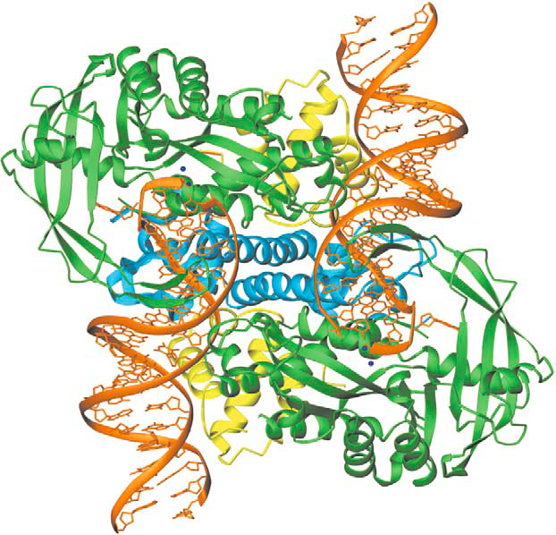
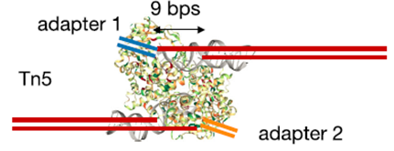
Tagmentation-mediated by preloaded Tn5 transposase produces DNA fragments with 5’ 9-base overhang ends
(Li et al. 2019)

Slide 22
(3) Shifting aligned reads
All reads aligning to the + strand were offset by +4 bp, and all reads aligning to the – strand were offset −5 bp (Buenrostro et al., 2013) to force the read ends to be the cutting centers.
Tools:
NucleoATAC
alignmentSieve command (deeptools)
shiftGAlignmentsList() function (ATACseqQC package).

Slide 23

(4) Splitting BAM files
split aligned reads into different bins:
Nucleosome-free
Mononucleosome
Dinucleosome
Trinucleosome
(Li et al. 2019)
objs <- splitGAlignmentsByCut(gal1, txs=txs,
genome=genome, outPath = outPath)

Slide 24
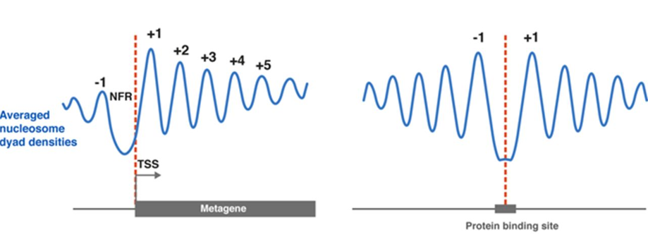
Nucleosome positioning around TSSs and TF-bound sites
A
B
(Baldi. 2018)

Slide 25
(5) Plotting global signal distribution around transcriptional start sites (TSSs)
enrichedFragments(): calculate signals around TSSs using the split BAM objects
featureAlignedHeatmap(): generate a heatmap showing signal distribution around TSSs
matplot(): summarize the signal distribution around TSSs using a density plot

Slide 26
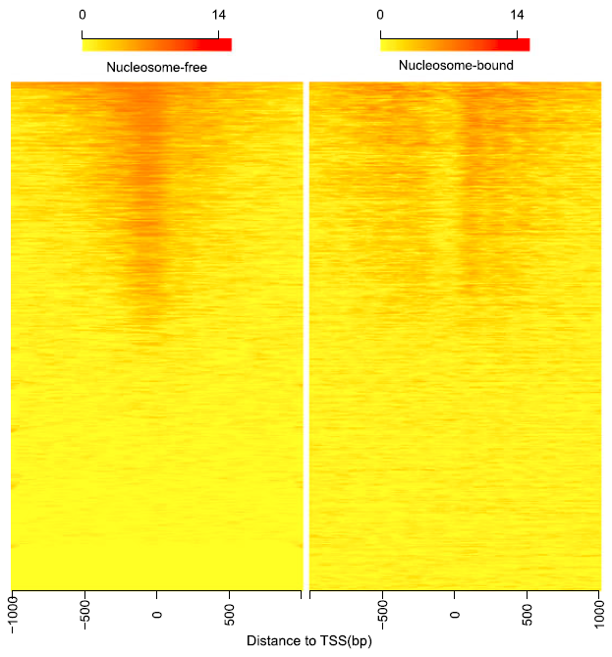
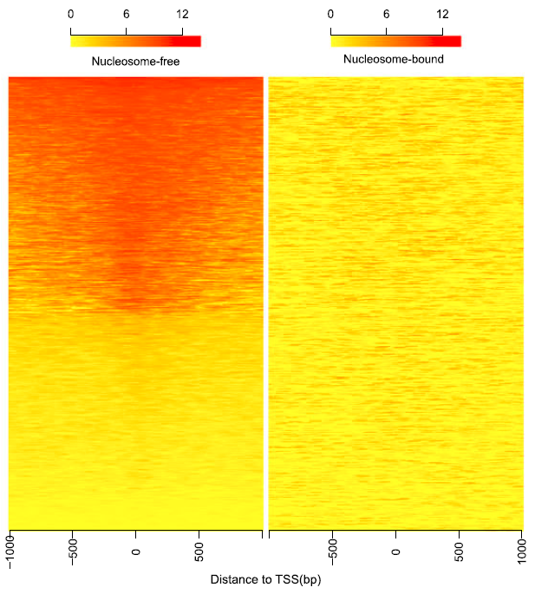
Heatmaps showing distribution of reads from different bins around TSSs
A (High quality)
B (Poor quality)
(Ou et al. 2018)

Slide 27
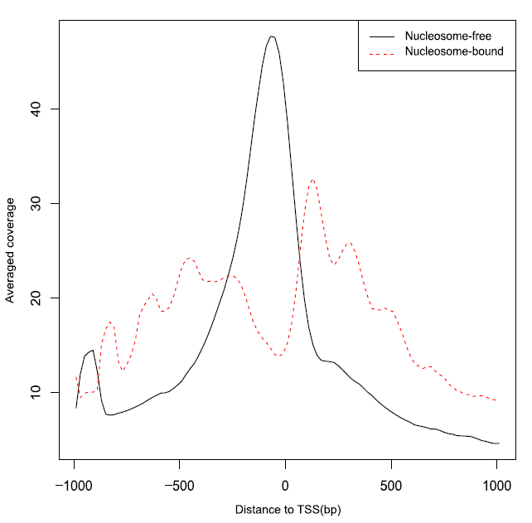
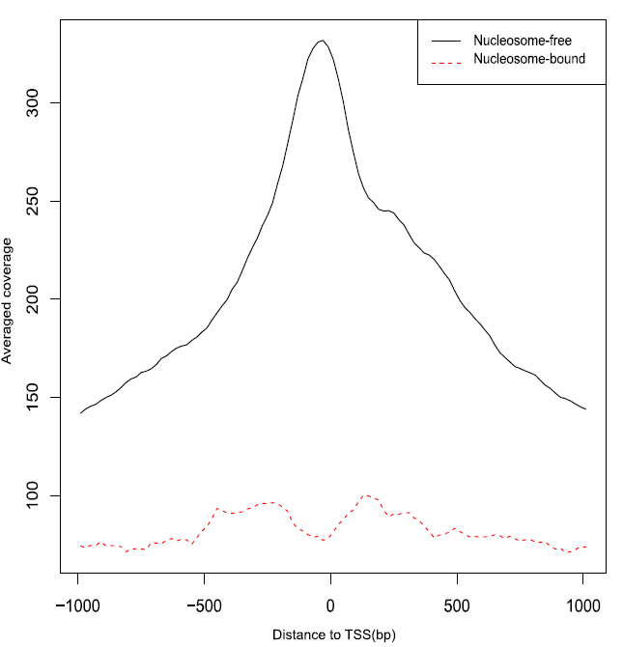
Density plots showing distribution of reads from different bins around TSSs
A (High quality)
B (Poor quality)
(Ou et al. 2018)

Slide 28
Transcription Start Site (TSS) Enrichment Score
GTF annotation file-dependent
Definition: https://www.encodeproject.org/data-standards/terms/#enrichment
TSSEscore()

Slide 29
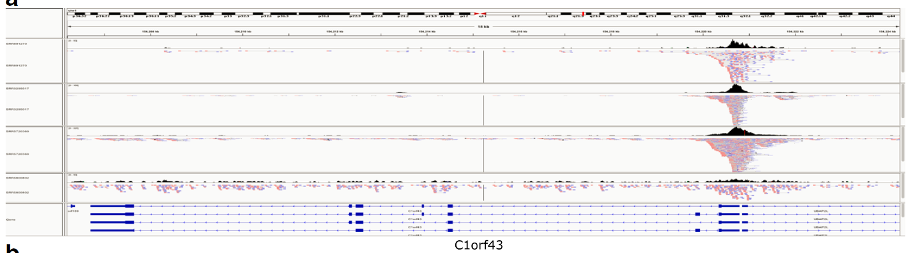
(6) Streamlining IGV snapshots showing reads distribution along HK genes
## access the function IGVSnapshot()
source(system.file("extdata", "IGVSnapshot.R", package = "ATACseqQC"))
## streamline IGV snapshots
IGVSnapshot(maxMem="lm", genomeBuild = "hg19",
bamFileFullPathOrURLs = bamFile,
geneNames = c("C1orf3", "GAPDH"))
(Ou et al. 2018)

Slide 30
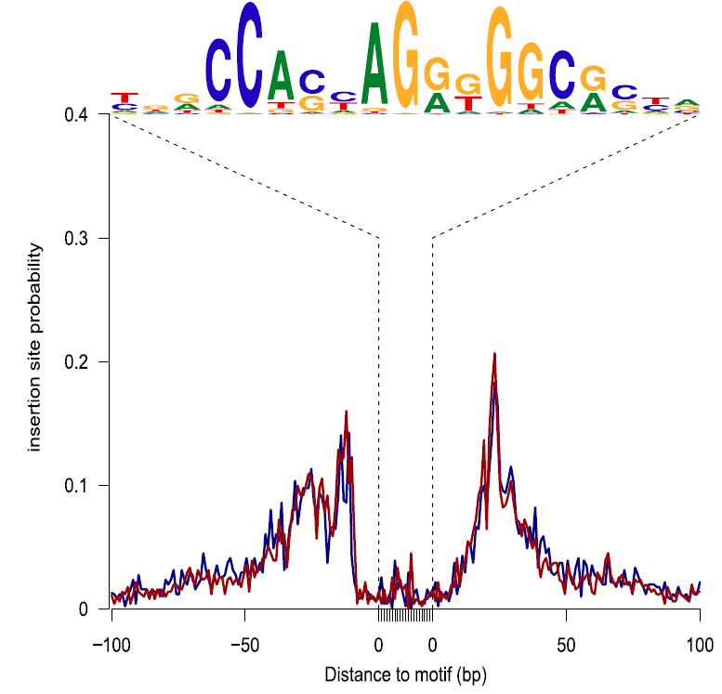
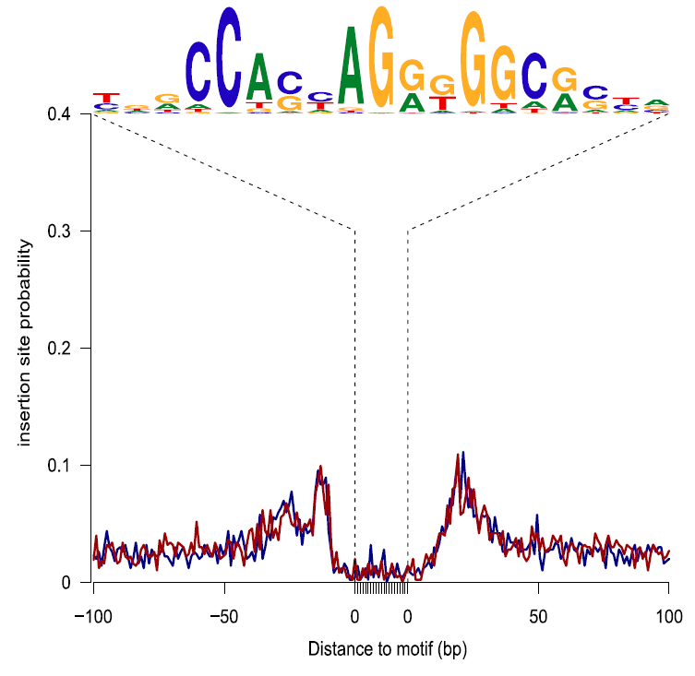
(7) Assessing footprints of DNA-binding factors
## get PWM of TFs
CTCF <- query(MotifDb, c("CTCF"))
CTCF <- as.list(CTCF) print(CTCF[[1]], digits=2)
sigs <- factorFootprints(shiftedBamFile, pfm=CTCF[[1]],
genome=genome, min.score="90%", seqlev=seqlev,
upstream=100, downstream=100)
A (High quality)
B (Poor quality)
(Ou et al. 2018)

Slide 31
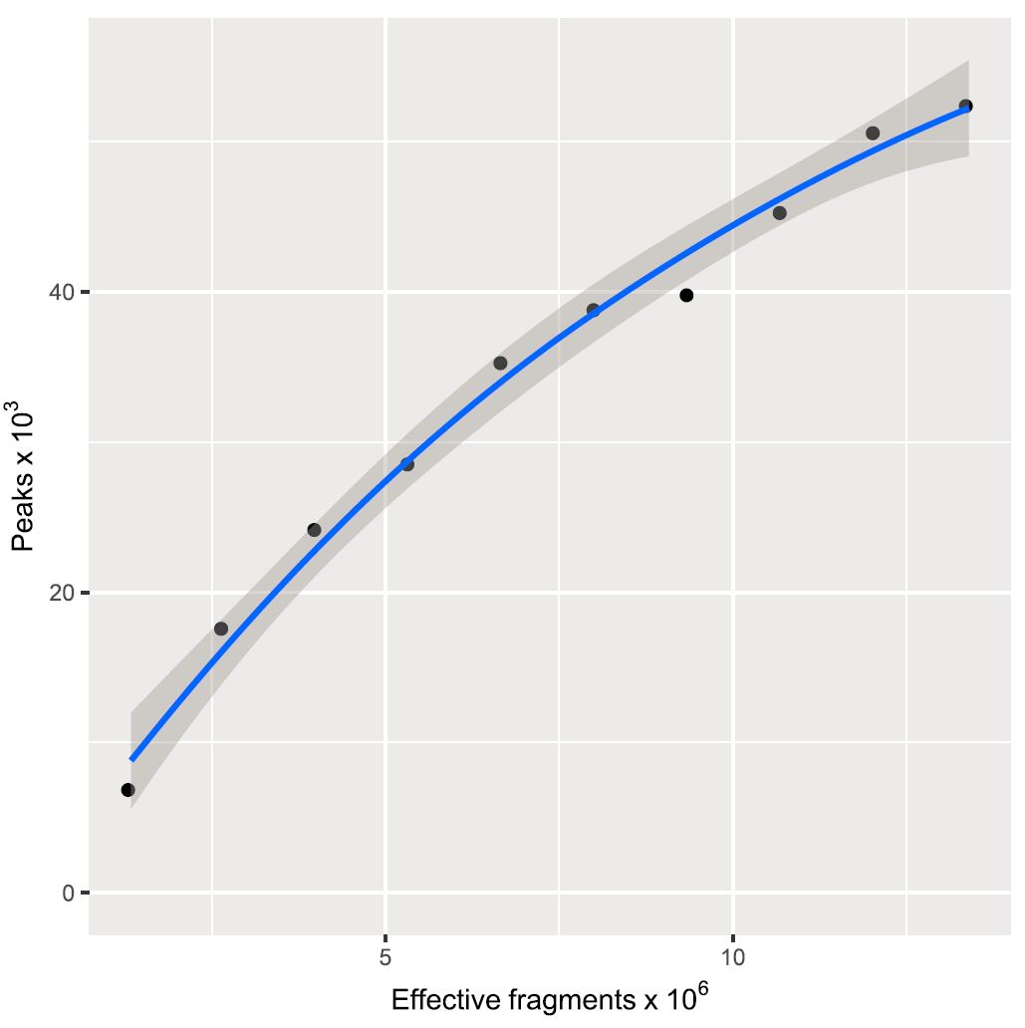
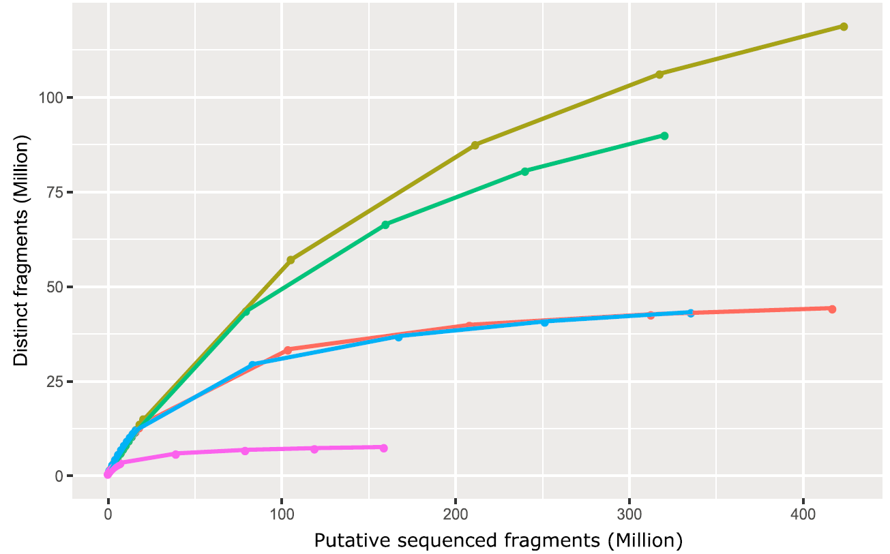
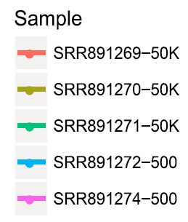
(8) Assessing sequencing depth and library complexity
saturationPlot()
estimateLibComplexity(readsDupFreq(bamFile))
(Ou et al. 2018)

Slide 32
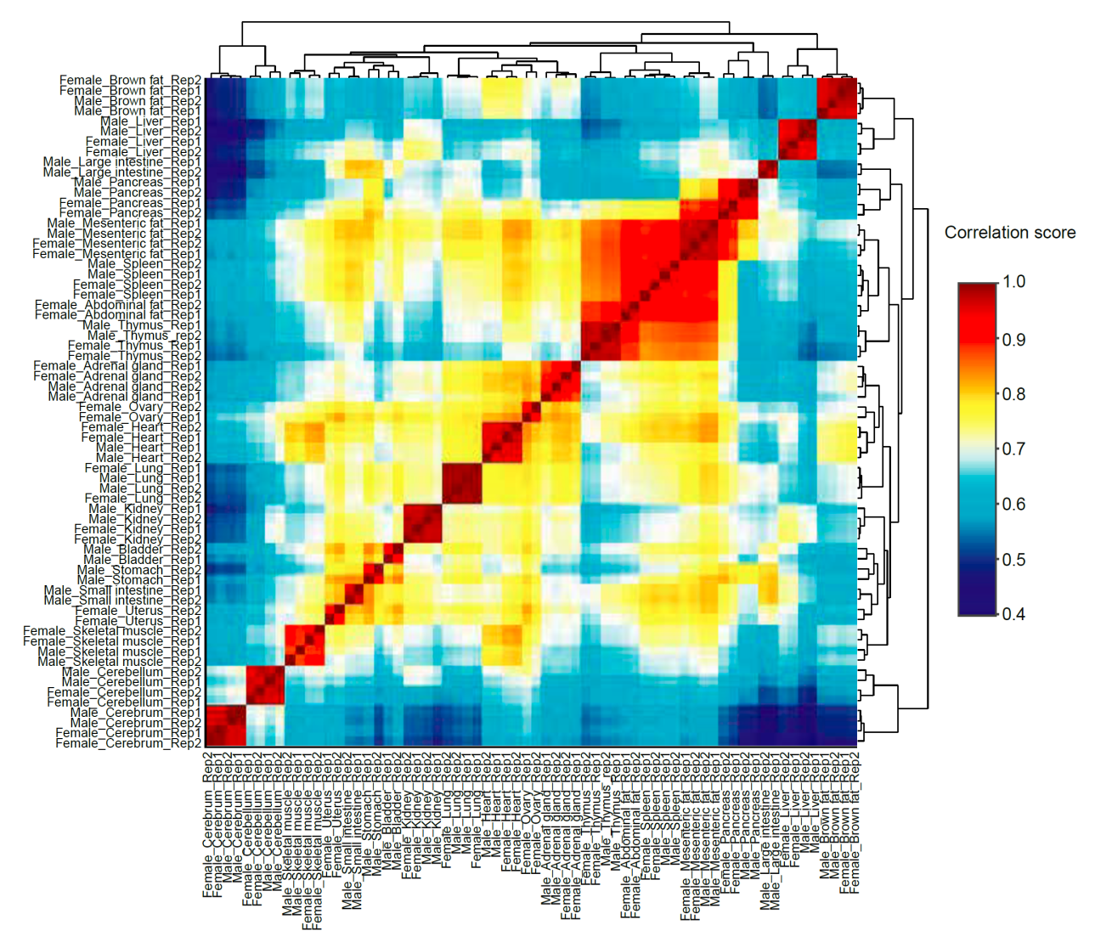
(9) Assessing similarities of replicates
plotCorrelation(GAlignmentsList(gals), txs,
seqlev="chr1")
Liu et al. An ATAC-seq atlas of chromatin accessibility in mouse tissues. Sci Data 6, 65 (2019) doi:10.1038/s41597-019-0071-0

Slide 33
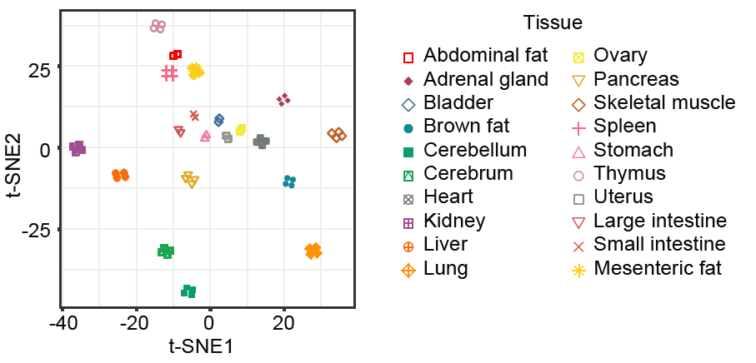
tSNE plots showing sample clustering
Liu et al. An ATAC-seq atlas of chromatin accessibility in mouse tissues. Sci Data 6, 65 (2019) doi:10.1038/s41597-019-0071-0

Slide 34
Outline
Introduction to the ATAC-seq technology
Preprocessing of ATAC-seq data
ATACseqQC workflow
Peak calling, filtering, and annotation
ATAC-seq data integration with other data
Best practices in ATAC-seq assays and ATAC-seq data analyses

Slide 35
ATAC-seq Peak calling
MACS2 options (https://github.com/taoliu/MACS) :
--format BAMPE
Effective genome size: -e
Generich (Better than MACS2) (https://github.com/jsh58/Genrich#method)
Removal of mitochondrial reads
Removal of PCR duplicates
Analysis of multi-mapping reads
Analysis of multiple replicates
Interpretation of alignments suitable for ATAC-seq (unpaired allowed)
HMMRATAC (specific for ATAC-seq peak calling
Tarbell and Liu T. Nucleic Acids Res. 2019 Sep 19;47(16):e91. doi: 10.1093/nar/gkz533
AIAP (https://github.com/Zhang-lab/ATAC-seq_QC_analysis): a recent development using pseudo reads, 75bp flanking each Tn5 insert site for peak calling and differential accessible region analysis. More sensitive.

Slide 36
Filtering peaks
Generate mappability-based blacklist
Blacklist filtering for peaks (bedtools)

Slide 37
Merging and comparing peaks
Peak reproducibility analysis using IDR (https://github.com/nboley/idr)
merge peaks from different libraries or different samples using Bedtools and Bedops
Collapsing multiple BED files into a master list by signal using Bedops: https://bedops.readthedocs.io/en/latest/content/usage-examples/master-list.html

Slide 38
Differential accessible region (DAR) analysis
diffReps (https://github.com/shenlab-sinai/diffreps)
Alignment file in the BED format as input
Not depends on peak callers
DESeq2
Read counts for each peak regions as input

Slide 39
Peak annotation
ChIPseeker
GREAT

Slide 40
Motif finding
Use HOMER for motif discovery.
It takes a peak file as input and checks for the enrichment of both known sequence motifs and de novo motifs.

Slide 41
Creating browser tracks
bamCovreage command (deeptools)
Genomic Interactive Visualization Engine (GIVE, https://zhong-lab-ucsd.github.io/GIVE_homepage/)

Slide 42
Outline
Introduction to the ATAC-seq technology
Preprocessing of ATAC-seq data
ATACseqQC workflow
Peak calling, filtering, and annotation
ATAC-seq data integration with other data
Best practices in ATAC-seq assays and ATAC-seq data analyses

Slide 43
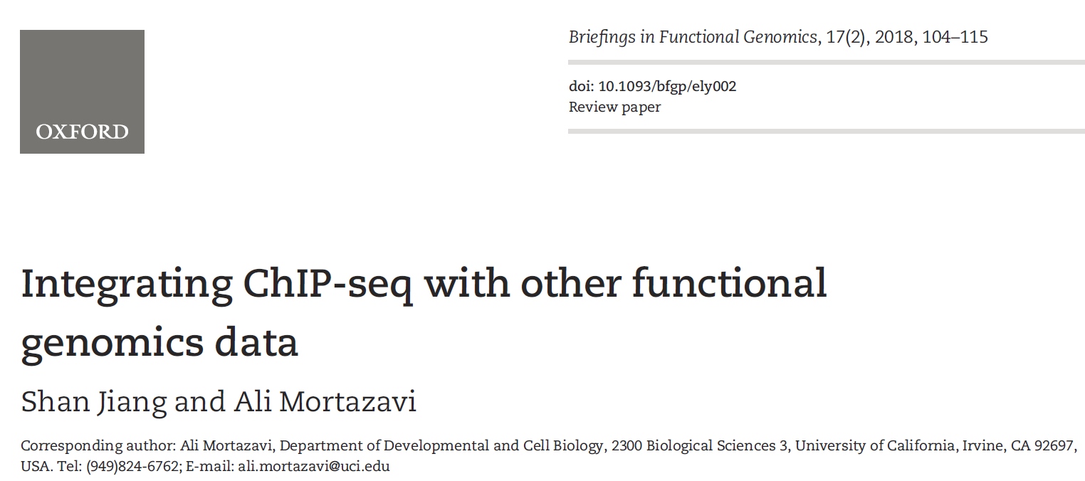
A good reference for ATAC-seq data integration

Slide 44
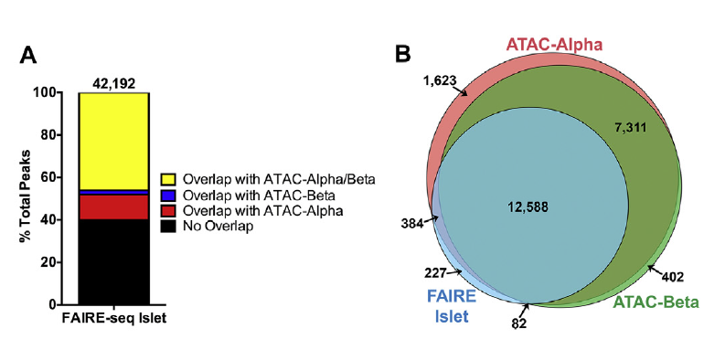
ATAC-seq data integration with other epigenetic data
ATAC-seq data can be integrated with histone and TF ChIP-seq data, FAIRE-seq data, and DNAse-seq data
Ackermann et al. Integration of ATAC-seq and RNA-seq identifieshuman alpha cell and beta cell signature genes. Molecular Metabolism, 5 (2016) 233e244

Slide 45
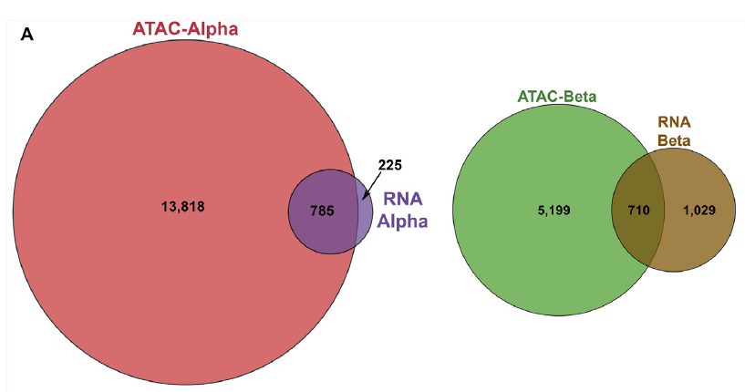
ATAC-seq data integration with RNA-seq data
Integration of ATAC-seq data with RNA-seq: differential accessible regions and differentially expressed genes
Ackermann et al. Integration of ATAC-seq and RNA-seq identifieshuman alpha cell and beta cell signature genes. Molecular Metabolism, 5 (2016) 233e244

Slide 46
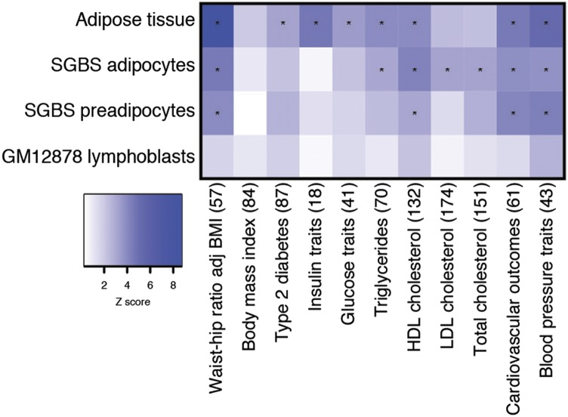
ATAC-seq data integration with genetic variants and GWAS data
Eg. Cardiometabolic GWAS loci are enriched in ATAC-seq peaks.
Cannon et al. Open Chromatin Profiling in Adipose Tissue Marks Genomic Regions with Functional Roles in Cardiometabolic Traits. G3 (Bethesda). 2019 Aug; 9(8): 2521–2533.

Slide 47
Outline
Introduction to the ATAC-seq technology
Preprocessing of ATAC-seq data
ATACseqQC workflow
Peak calling, filtering, and annotation
ATAC-seq data integration with other data
Best practices in ATAC-seq assays and ATAC-seq data analyses

Slide 48
Best practices for ATAC-seq assays
Digest away background DNA (from medium/dead cells) using DNase
Use fresh/cyropreserved cells/tissues to isolate nuclei
Reduce mitochondrial/chloroplast DNA contamination as much as possible: bamQC() using Omni-ATAC method (https://www.nature.com/articles/nmeth.4396)
Optimize the ratio of the amount of Tn5 transposase to the number of nuclei: fragSizeDist()
Optimize the number of PCR cycles: bamQC()
Perform paired-end (PE) sequencing, e.g., 2 x 50bp
Sequence > 50M PE reads (~200 M for footprint discovery): saturationPlot(), estimateLibComplexity()

Slide 49
Best practices for ATAC-seq data analyses
Perform raw read QC before alignment--FASTQC
Perform post-alignment QC--ATACSeqQC
Perform peak calling using a peak caller, such as MACS2 in non-broadPeak mode, Generich, or HMMRATAC
Perform post-peak calling QC
Annotate peaks to nearest genes and generate peak distribution among genomic features--ChIPpeakAnno
Obtain functions of genes associated to peaks using the Genomic Regions Enrichment of Annotations Tool (GREAT)

